Slide 1
Exploratory Data Analysis and Forecasting of Apple Inc. (AAPL) Stock Price
ITC 6002: Exploring and Analyzing Data
Final Project
Team Members: Nikitas Valtadoros, David Frederick, and Dimitrios Bechrakis
Deree – The American College of Greece
Dr. Dimitris Milioris
December 16, 2025

Slide 2
Agenda
Objective & Dataset
Part A: Data Preparation
Part B: Year 1 Analysis (The Bull Run)
Part C: Year 2 Analysis (The Volatile Recovery)
Part D: Comparative Analysis
Part E: Peer-Adjusted Forecasting
Conclusion

Slide 3
The Objective
Goal: Forecast AAPL stock prices for years 2023 and 2024 using Time Series Analysis.
The Challenge: Predict the closing price of Apple stock for 1-11 months ahead of our training data.
Dataset Choice: AAPL stock as financial data are often characterized by noise and lack of seasonality.
Tools: Python (Pandas, Statsmodels, Holt-Winters).

Slide 4
Part A: Data Preparation
Source: Yahoo Finance (Daily Data).
Cleaning: Handled missing values (business days).
Outlier Detection: Used Z-Score Analysis.
Result: 7 significant outliers identified
Decision: Kept them to reflect genuine market volatility.

Slide 5
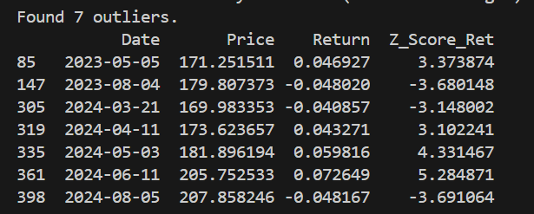
Outliers
Decision: Kept them to ensure our model evaluation reflected true market conditions.

Slide 6
Part B: Year 1 Analysis (2023)
Methodology
Training Set: January (21 Days).
Test Set: Feb - Dec (Rest of Year).
Models Used: Naïve, Moving Average (n=2), SES a=0.9).
Optimization Results
High a=0.9 indicates the model prioritizes recent data, essentially mimicking the Naïve approach.
Performance (The Problem)
MAPE: ~17.6% (High Error).
Observation
The models produced a "flatline" forecast, completely missing the strong upward trend from $143 to $190.

Slide 7
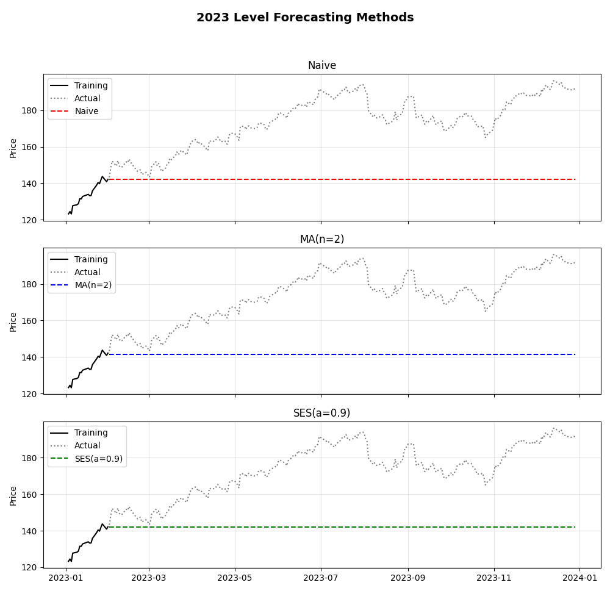
Year 1 Models Comparison (2023)
Context: Strong "Bull Run" (Price rose from $143 to $190).
Models: Naïve, Moving Average (n=2), SES (a=0.9).
Forecast: Produced a flatline, assuming history repeats itself.
Result: Completely missed the upward momentum.
Error: High MAPE of ~17.62%.

Slide 8
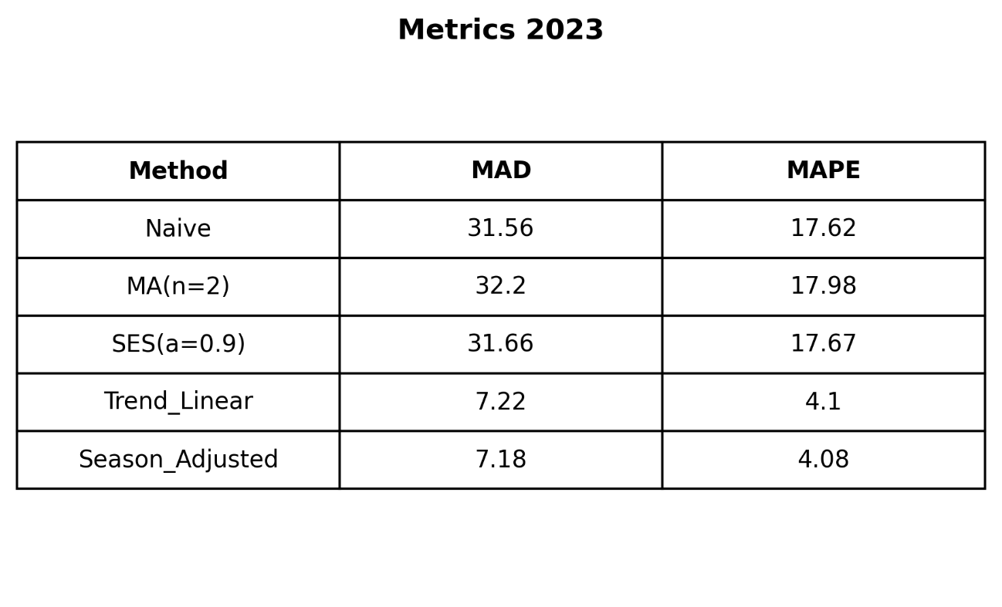
Year 1 Metrics Level (2023)
The Winner: Seasonal Adjusted Model.
Lowest Error: MAD 7.18 / MAPE 4.08%.
Why: Captured both the growth trajectory and monthly oscillations.
The Loser: Level Models (Naïve, MA).
High Error: MAPE ~17.6%.
Why: Failed to react to the breakout rally, staying "flat".
Verdict: In a trending market (Bull Run), identifying the deterministic trend is critical for accuracy.

Slide 9
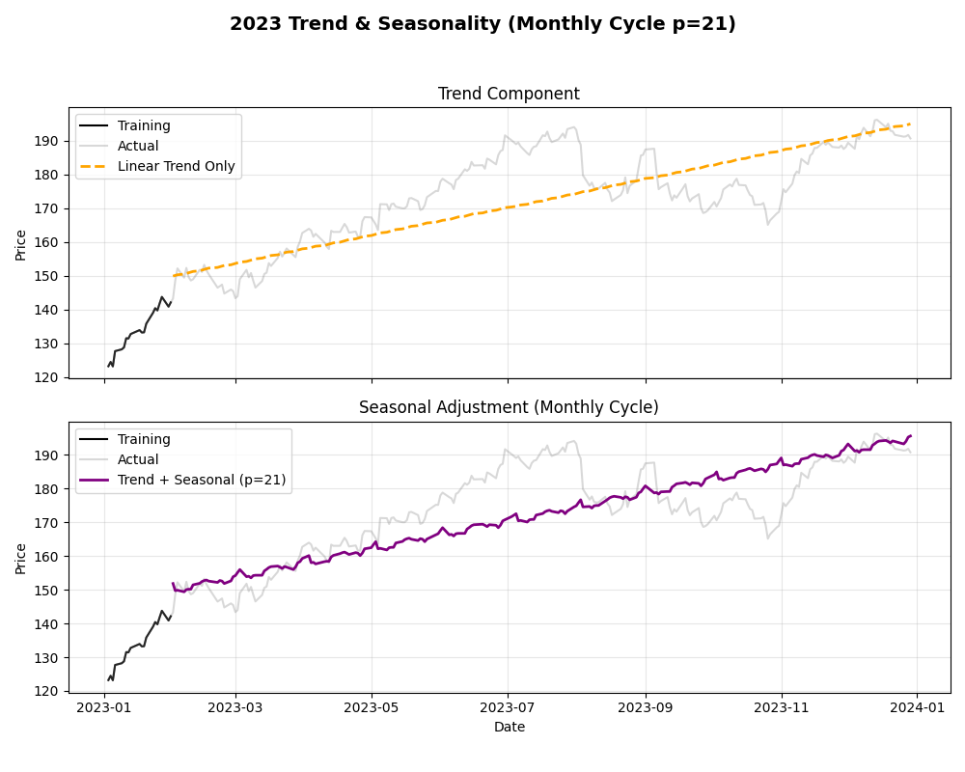
Part B: Trend Models (2023)
Solution: Holt’s Linear Trend + Seasonal Adjustment (p=21 days).
Impact: The model successfully projected the slope forward.
Accuracy: MAPE collapsed from 17.6% to 4.08%.
Key Stat: MAD reduced from 31.56 to 7.18.
Insight: The market was driven by a deterministic trend, not random noise.

Slide 10
Year 1 Summary
To summarize Year 1, the numbers tell the whole story. On one hand, the Level models failed significantly with a 17% error because they couldn't see the trend. On the other hand, the Seasonal Adjusted model was the clear winner. By mathematically modeling both the linear growth and the 21-day cycle, it achieved a remarkably low error of just 4.08%. This proves that for 2023, the 'Trend' was the most significant component of the price action.

Slide 11
Part C: Year 2 Analysis (2024)
Context: A "Dip-and-Recover" year. Prices dropped in Jan but rallied later.
Performance: Surprisingly better than Year 1.
MAPE: 13.58% (vs 17.6% in 2023).
MA(n=2): Outperformed Naïve (13.25%) by smoothing the dip.
Why? The "dip" kept prices closer to the January baseline for longer, unlike the explosive rally of 2023.

Slide 12
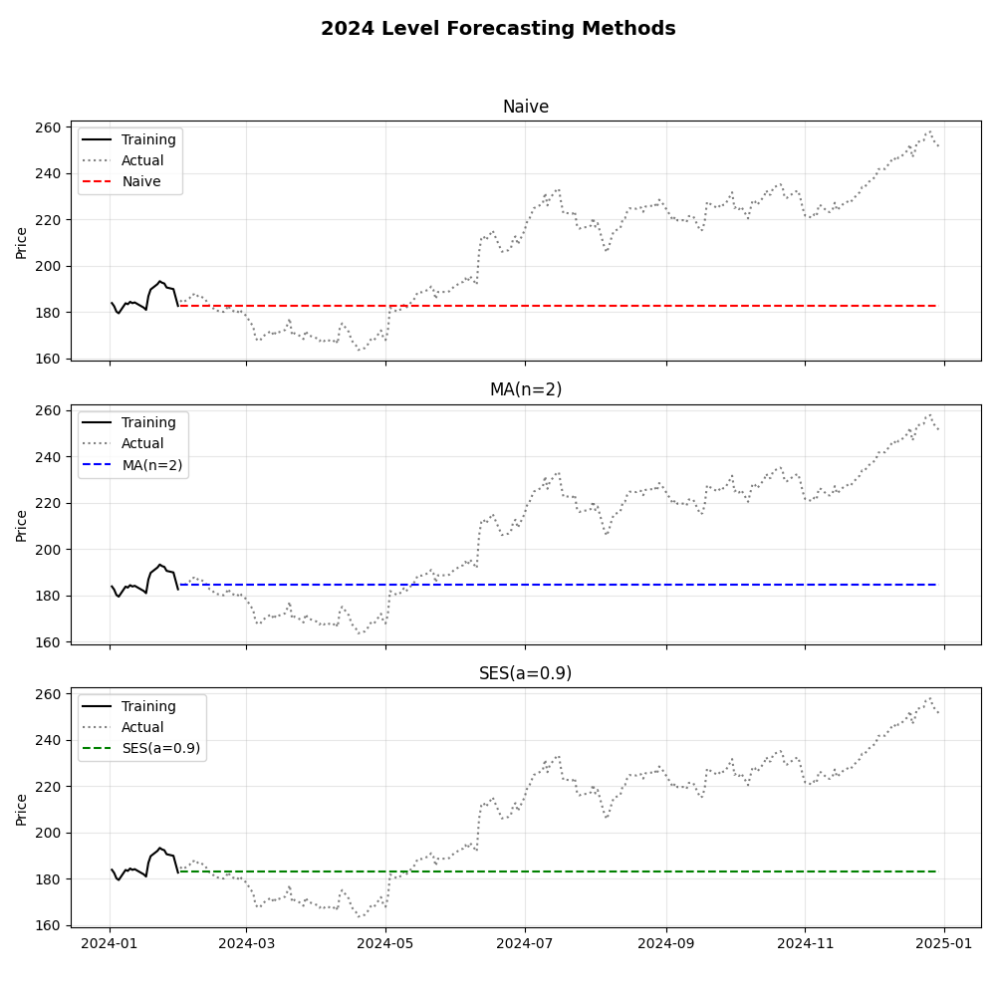
Year 2 Models Comparison (2024)
Context: A "Dip-and-Recover" year. Prices dropped in Jan but rallied later.
Performance: Surprisingly better than Year 1.
MAPE: 13.58% (vs 17.6% in 2023).
MA(n=2): Outperformed Naïve (13.25%) by smoothing the dip.
Why? The "dip" kept prices closer to the January baseline for longer, unlike the explosive rally of 2023.

Slide 13
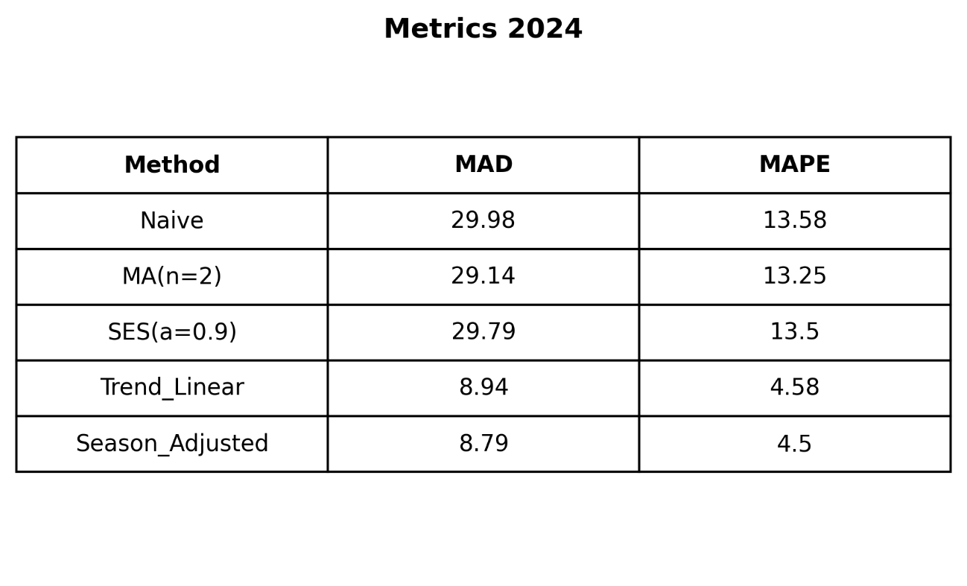
Year 2 Metrics Level (2024)
Comparison
Level Models: Improved (13.5% error) but still missed the recovery.
Trend Models: Remained superior (4.5% error).
Key Takeaway
Volatility: Increased standard deviation (Risk).
Stability: Structural models (Trend) handle risk better than static averages.

Slide 14
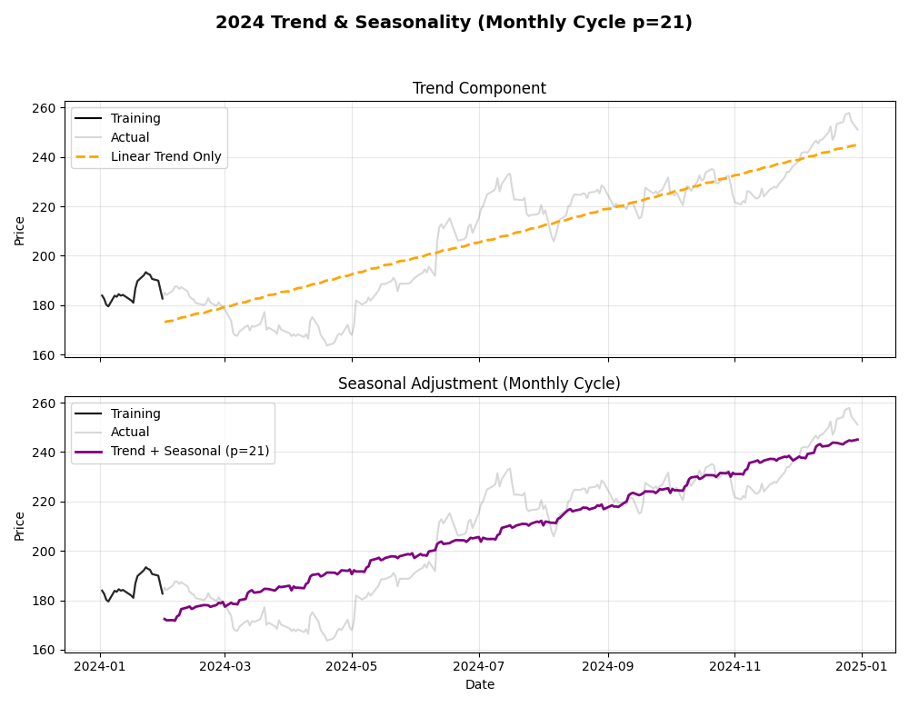
Part C: Trend Diagnosis (2024)
Level Models (The Surprise):
Performed better than Year 1 (MAPE 13.58% vs 17.6%).
Trend Models (The Winner):
Seasonal Adjusted Model remained superior (MAPE 4.50%).
Key Insight: Structural models proved robust across both Momentum (2023) and Volatility (2024) environments.

Slide 15
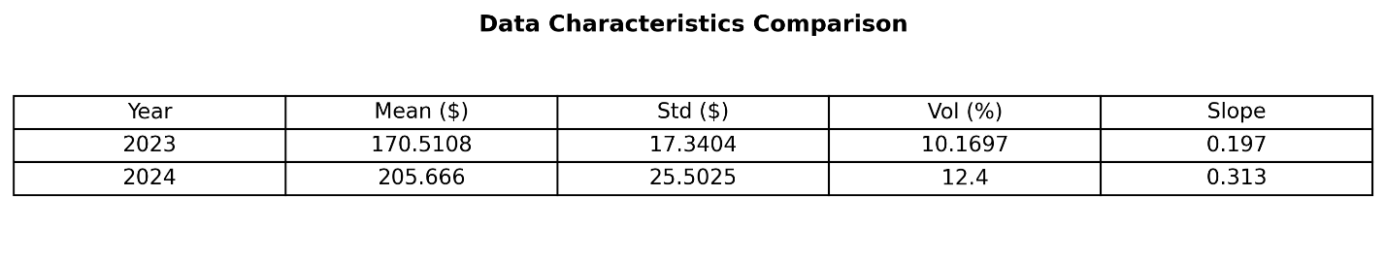
Part D: Comparative Analysis
Higher average price in 2024 → the mean jumps from ~$170 to ~$206, showing a clear upward shift in price level.
Volatility increased in 2024 → both standard deviation and volatility (%) are noticeably higher, meaning rougher price movements.
More unstable market conditions → the rise in dispersion suggests forecasting became harder in 2024.
Stronger upward trend in 2024 → the higher slope indicates faster growth compared to 2023.
Overall takeaway → 2023 looks more stable and predictable, while 2024 is more aggressive but riskier.

Slide 16
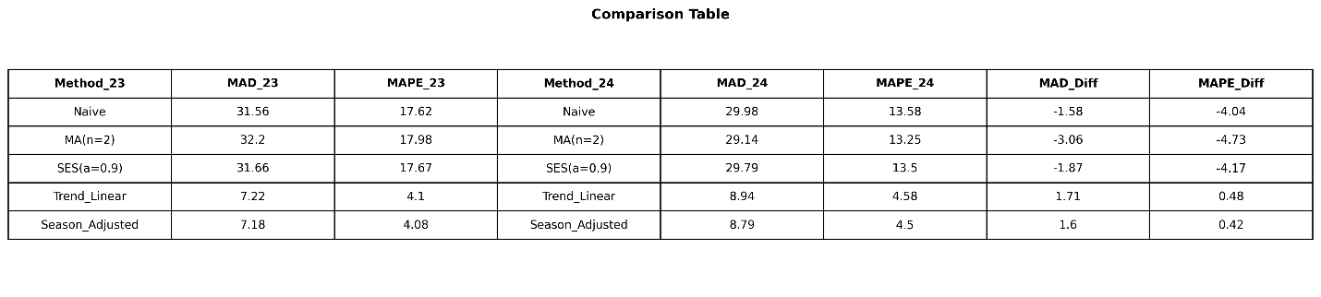
Part D: Comparative Analysis
Market Context: Shifted from Aggressive Growth (2023) to High Volatility (2024).
The "Static" Paradox
Level Models (Naïve/MA) performed better in the volatile year (MAPE dropped from 17.6% ➔ 13.6%).
Reason: The "dip-and-recover" pattern kept prices closer to the January baseline compared to the straight rally of 2023.
The "Trend" Consistency
Holt’s Linear Trend remained stable and superior across both years.
MAPE remained low: 4.10% (2023) vs. 4.58% (2024).
Key Takeaway: Trend models are robust to market changes; Static models rely on market "luck".

Slide 17
Part E: Forecast Adjustment with similar Datasets
Methodology: Reference Class Forecasting (RCF) applied to comparable firms.
Peer Group: A reference set of 10 major technology companies (e.g., Microsoft, Google, Nvidia).
Evaluation Metric: Actual-to-Forecast (A/F) ratio to measure systematic bias.
Objective: Adjust forecasts to account for persistent sector-wide drift and over/under-estimation.

Slide 18
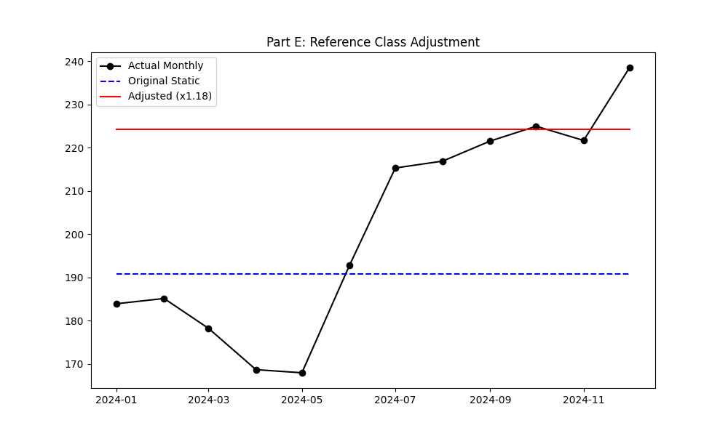
Results & Analysis
Sector Benchmarking: Analyzed a reference class of 10 peer tech stocks to mitigate specific model bias.
The Adjustment Factor: Calculated a multiplier of 1.18, indicating the peer group performed 18% better on average.
Market Context: The adjustment accounts for the strong 2024 Tech Rally that the baseline Seasonal Model underweighted.
Final Outcome: The adjusted forecast (Red Line) successfully corrects the initial underestimation, aligning with the actual bullish trend.

Slide 19
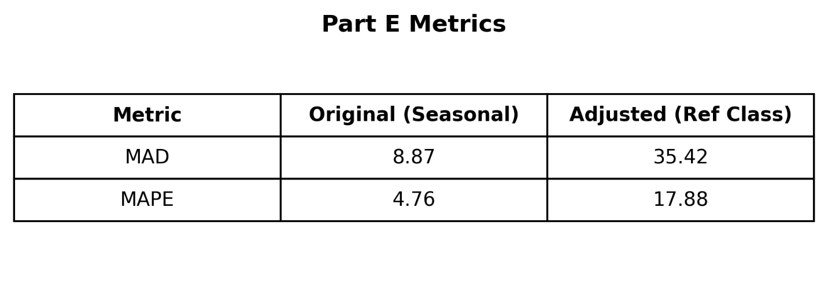
Part E Metrics
Methodology: Applied a 1.18x adjustment factor (derived from 10 tech peers) to account for sector-wide momentum.
Performance Metrics
Original (Seasonal): Demonstrated high accuracy with a low MAPE of 4.76%.
Adjusted (Ref Class): Resulted in higher error rates (MAPE: 17.88%, MAD: 35.42).
Analysis: The adjustment led to an overestimation of the price. While the sector rallied, this specific stock followed its seasonal trend more closely than the aggressive peer average.
Conclusion: The Original Seasonal Model remains the superior predictor and provides the most reliable forecast.

Slide 20
Conclusion
Limitation of Static Models
Level-based models (Naive, MA, SES) struggled to capture directional momentum.
Relying on fixed baselines caused them to consistently lag behind the upward trends in both 2023 and 2024.
Superiority of Structural Decomposition
The Seasonal Adjusted Model (Trend + Seasonality p=21) was the clear winner.
By isolating the underlying market structure from random noise, it maintained low error rates across both stable and volatile market conditions.
Key Takeaway
Mathematically accounting for the 21-day trading cycle proved significantly more valuable than merely smoothing past price history.

Slide 21
Conclusion
The "Outside View" Experiment
We benchmarked Apple against a peer group of 10 tech stocks, which rallied ~18% in 2024.
Attempted to correct potential bias by applying this sector-wide momentum to our forecast.
Divergence from the Pack
Incorporating this external benchmark drastically increased error (MAD spiked from 8.87 to 35.42).
This indicates Apple’s price action decoupled from the broader sector’s aggressive growth phase.
Final Conclusion
While external benchmarks provide context, the "Inside View" (derived from the asset’s own historical data) remains the superior predictor when a specific company does not share the broader market's trend.

Slide 22
Thank you for your attention!

